Slide 1

CAR SALES ANALYSIS
Presented by:
Ankit Kumar
SQL PROJECT

Slide 2
PROJECT OBJECTIVE
The objective of the Car Sales Analysis Project
Analyze Market Trends and Customer Preferences: Identify sales trends over time and understand customer choices in fuel type, transmission, and ownership history.
Evaluate Performance and Pricing Insights: Examine key performance metrics like mileage and engine capacity, and provide pricing insights by categories such as year, fuel type, and seller type.
Identify Top-Performing Models: Highlight popular car models and brands with high resale value to guide inventory and marketing strategies.
Assess Usage Patterns and Ownership Impact: Analyze mileage and ownership history to understand vehicle usage trends and how ownership affects value and demand.

Slide 3
DATABASE SCHEMA
Column name | Data Type
Name Year Selling_Price KM_Driven Fuel Seller_Type Transmission Owner Mileage Engine Max_Power Torque Seats | Text Int Int Int Text Text Text Text Text Text Text Text Int

Slide 4
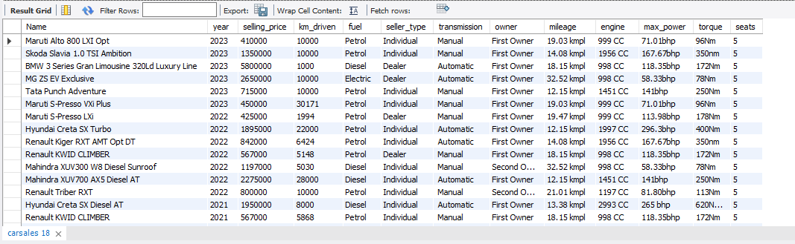
1. Read data
Qwery: SELECT * FROM carsales ;

Slide 5
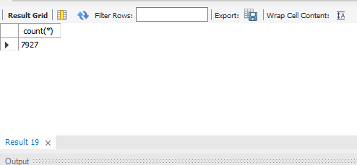
2. How many cars are listed in the dataset?
Qwery: SELECT COUNT(*) FROM carsales;

Slide 6
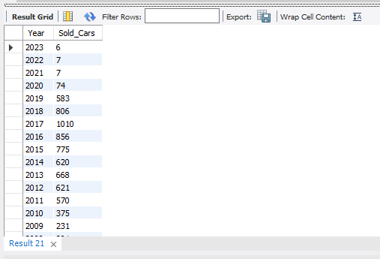
3. How many cars are sold for each year?
Qwery: SELECT year AS Year, COUNT(*) AS Sold_Cars FROM carsales GROUP BY year;

Slide 7
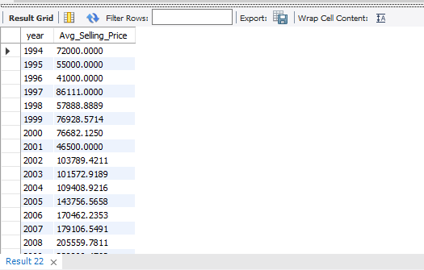
4. What is the average selling price of cars listed each year?
Qwery: SELECT year, AVG(selling_price) AS Avg_Selling_Price FROM carsales GROUP BY year ORDER BY year ASC;

Slide 8
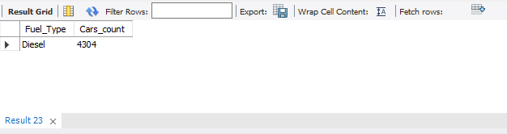
5. Which fuel type is the most popular in the dataset?
Qwery: SELECT fuel AS Fuel_Type, COUNT(*) AS Cars_count FROM carsales GROUP BY fuel ORDER BY Cars_count DESC LIMIT 1;

Slide 9
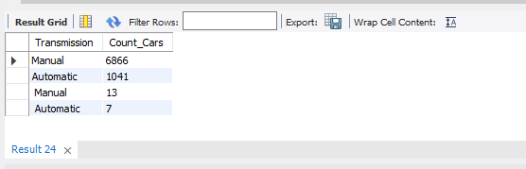
6. How many cars are available by each transmission type (Manual vs. Automatic)?
Qwery: SELECT transmission AS Transmission, COUNT(*) AS Count_Cars FROM carsales GROUP BY transmission ORDER BY Count_Cars DESC;

Slide 10
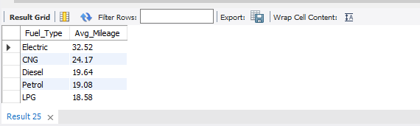
7. What is the average mileage for each fuel type?
Qwery: SELECT fuel AS Fuel_Type, ROUND(AVG(mileage), 2) AS Avg_Mileage FROM carsales GROUP BY Fuel_Type ORDER BY Avg_Mileage DESC;

Slide 11
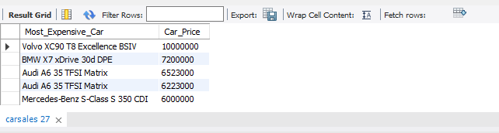
8. Which are the top 5 most expensive cars in the dataset?
Qwery: SELECT Name AS Most_Expensive_Car, selling_price AS Car_Price FROM carsales ORDER BY Car_Price DESC LIMIT 5;

Slide 12

9. What is the average selling price for each fuel type?
Qwery: SELECT fuel AS Fuel_Type, ROUND(AVG(selling_price), 0) AS Avg_Selling_Price FROM carsales GROUP BY Fuel_Type ORDER BY Avg_Selling_Price DESC;

Slide 13
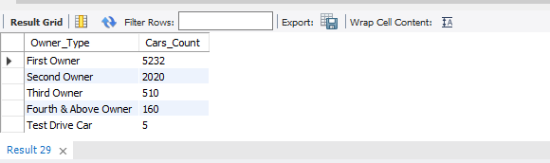
10. How many cars are listed for each owner type (e.g., First Owner, Second Owner)?
Qwery: SELECT owner AS Owner_Type, COUNT(*) Cars_Count FROM carsales GROUP BY Owner_Type ORDER BY Cars_Count DESC;

Slide 14
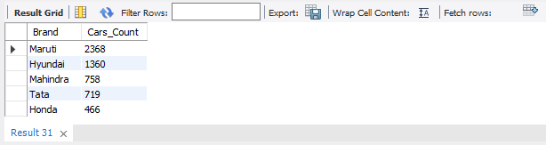
11. Which are the top 5 most popular car brands?
Qwery: SELECT SUBSTRING_INDEX(Name, ' ', 1) AS Brand, COUNT(*) AS Brand_Count FROM carsales GROUP BY Brand ORDER BY Brand_Count DESC LIMIT 5;

Slide 15
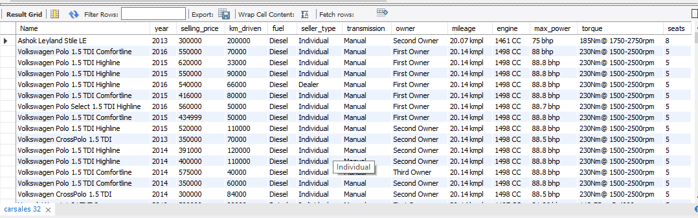
12. Which cars have a mileage greater than 20 kmpl?
Qwery: SELECT * FROM carsales WHERE mileage > 20 ORDER BY mileage ASC;

Slide 16
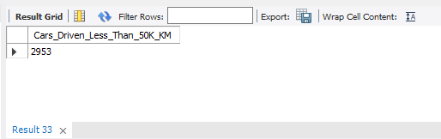
13. How many cars have been driven less than 50,000 kilometers?
Qwery: SELECT COUNT(*) AS Cars_Driven_Less_Than_50K_KM FROM carsales WHERE km_driven < 50000;

Slide 17

14. What is the average selling price based on seller type (Individual vs. Dealer)?
Qwery: SELECT seller_type, AVG(selling_price) AS Avg_Selling_Price FROM carsales GROUP BY seller_type ORDER BY Avg_Selling_Price DESC;

Slide 18
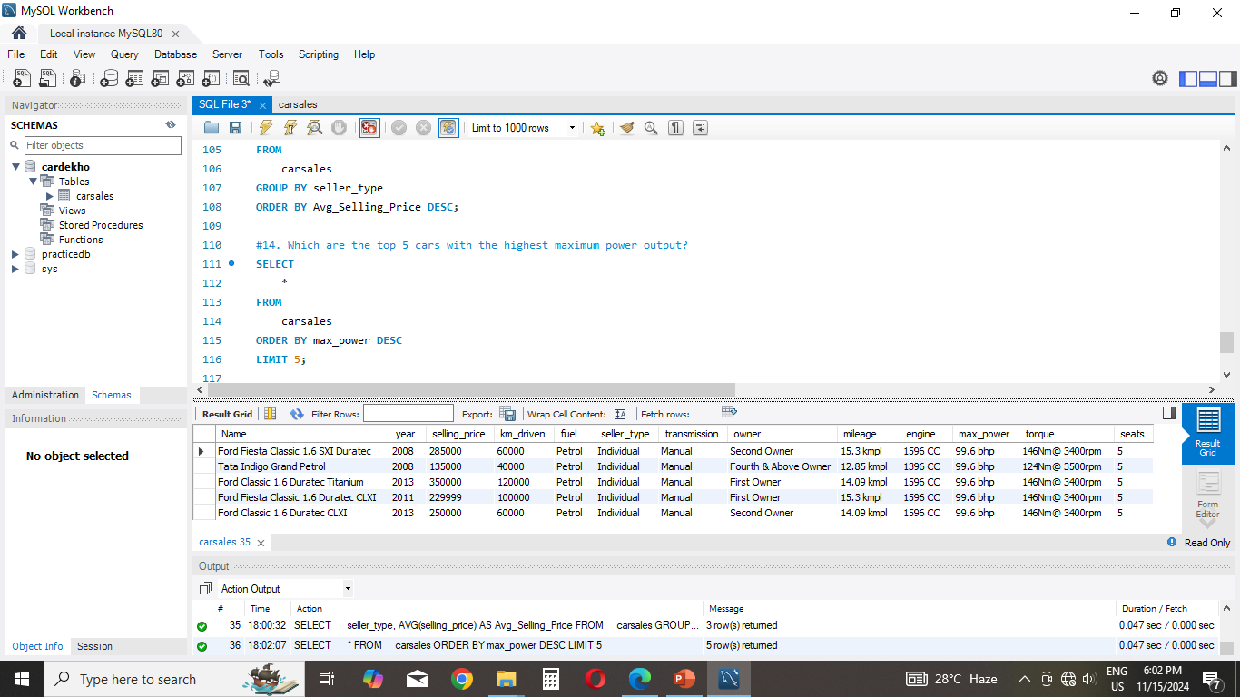
15. Which are the top 5 cars with the highest maximum power output?
Qwery: SELECT * FROM carsales ORDER BY max_power DESC LIMIT 5;

Slide 19
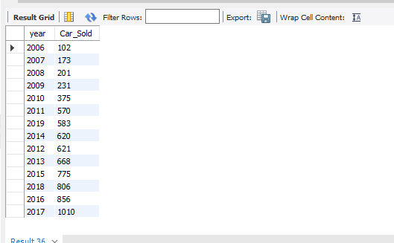
16. In which years were more than 100 cars sold?
Qwery: SELECT year, COUNT(*) AS Car_Sold FROM carsales GROUP BY year HAVING Car_Sold > 100 ORDER BY Car_Sold ASC;

Slide 20
THANK YOU
Thank you for reviewing the insights from: Car Sales Analysis Project. This project showcases how data-driven decision-making can uncover trends, optimize operations, and enhance strategies.
For further analysis or questions, feel free to connect!
Instagram: ANKITTSIGN
Email: ankitbaech@gmail.com

